Slide 1
Welcome!
Please turn your camera ON; microphone on but MUTED
You can unmute to talk by pressing the space bar
Video settings
In View options – choose Gallery
Use Gallery View to see all participants as well as the presentation
You can adjust the size of the side panel by sliding the line in the middle to see more participants
Raise hands either physically or use the icon in Participants (bottom of screen)
Feel free to add questions to Chat
Please rename yourself and include your type preferences: click on the icon in the picture of yourself, choose Rename, and then add your name and type.

Slide 2
with Dr. Greg Huszczo & Christy Hicks (as your guides)
Navigating Change: Personally, Professionally & Organizationally
More resources available at:
www.TeamsLeadershipChange.com
April 7, 2022
Notes:
Introductions of Greg and Christy

Slide 3
Change is the new Normal
CHANGES
CHANGES
CHANGES
CHANGES
Notes:
Most important topic of this century. DON’T give examples here! Advance to the next slide.

Slide 4
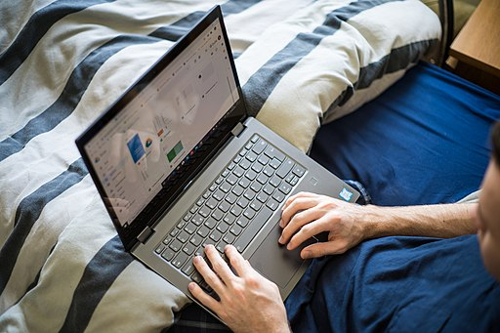
changes we have experienced recently
Notes:
The COVID epidemic
Brexit
Social Justice Movements (Black Lives Matter & Me Too, for example)
Climate Change
Technological Changes
Invasion of Ukraine
Ubiquity of Social Media
Zoom and other platforms
Electric Vehicles, Self-Driving
Working from Home
People Quitting/Changing Jobs

Slide 5
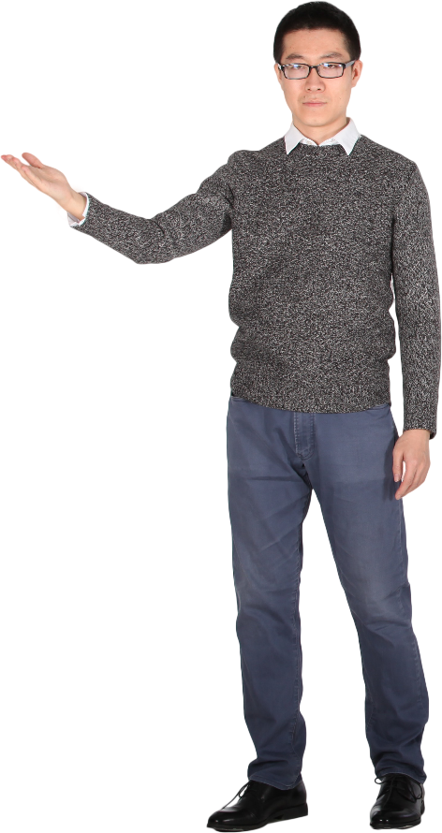
And most of us have experienced:
 | Personal changes
 | Professional changes
 | Organizational changes

Slide 6
How do you navigate change?
Notes:
Ask for “shout outs.” We’d like to hear from 2 or 3 people. If you don’t have a chance to share verbally, feel free to post in the chat.

Slide 7
How do youR type preferences influence how you navigate Changes?
E Extraversion
People who prefer Extraversion tend to focus on the outer world of people and things.
I Introversion
People who prefer Introversion tend to focus on the inner world of ideas and impressions.
S Sensing
People who prefer Sensing tend to focus on the present and on concrete information
gained from their senses.
N iNtuition
People who prefer Intuition tend to focus
on the future, with a view towards
patterns and possibilities.
T Thinking
People who prefer Thinking tend to
base their decisions primarily on logic and
on objective analysis of cause and effect.
F Feeling
People who prefer Feeling tend to base their decisions primarily on values and on subjective evaluation of person-centered norms.
J Judging
People who prefer Judging tend to like a
planned and organized approach to life
and prefer to have things settled.
P Perceiving
People who prefer Perceiving tend to like a
flexible and spontaneous approach to life and
prefer to keep their options open.

Slide 8
with Dr. Greg Huszczo & Christy Hicks (as your guides)
Navigating Change: Personally, Professionally & Organizationally
More resources available at:
www.TeamsLeadershipChange.com
Notes:
Mention the book project, and that ir has many stories for each phase of the change model, as well as tools & techniques.

Slide 9
7 Ps of CHANGE
 | Provocation
 | Past
 | Present
 | Picture
 | Plan/Prepare
 | Pull/Push
 | Promised Land

Slide 10
PROVOCATION Look out! What was that?
1

Slide 11
PROVOCATION: Look Out! What was that?
1
Noticed something is not quite right. Why?
What has changed in your external or internal environment?
Knowing it is time to pay attention and not be complacent
Notes:
Removed this question, since the participants won’t be discussing it in a break-out room: BUT I WILL SAY THIS OUT LOUD
How might your type preferences influence the way you deal with a provocation (regardless whether it is a disruption or an opportunity)?

Slide 12
Speculations regarding type preference influences on navigating PROVOCATION
E’s: May tend to verbalize their reactions to the provocation and respond quite quickly.
I’s: May tend to want to have time to think about the provocation and reflect on what it might impact.
S’s: May tend to notice the details associated with the provocation and take things said more literally.
N’s: May tend to link the provocation to other things going on in their lives and take a more conceptual view of it.
T’s: May tend to critique the objective aspects of the provocation and develop arguments against it.
F’s: May tend to react emotionally and examine who else might be impacted by it.
J’s: May tend to quickly dismiss the provocation or search for a quick fix to maintain their status quo.
P’s: May tend to look at the pros and cons of the provocation and may postpone dealing with it.
Notes:
Warn them…this might look messy but let us talk you through it…We wanted to include more details in case you want them later

Slide 13
PAST Look back! Have you seen this before?
2

Slide 14
PAST: Look back! Have you seen this before?
2
Does the provocation feel familiar?
Time to review your past, respect it, learn from it
What can you learn from your past peaks and valleys?
How can you let go of your past? (But still have the memories/lessons learned)
Notes:
Removed this question, since the participants won’t be discussing it in a break-out room: BUT I WILL SAY THIS OUT LOUD
How might your type preferences influence the way you deal how you reflect on the past and extract the lessons you have learned from experience?

Slide 15
Speculations regarding type preference influences on reflecting about PAST experiences
E’s may tend toward taking action and thus maybe cutting reflection time to the minimum. At least they might be a source of energy to push us into the next phase.
I’s may tend to take too much of an idiosyncratic approach to reflecting on past change experiences? At least they may make sure time is dedicated to reflect before acting.
S’s may focus too much on specific details of past events and cause an overemphasis on a piece of a past disaster or a piece of a past success. At least the S’s might make sure they just don’t gloss over our overall remembrance of an event and honor the details of our past.
N’s may turn current provocations into “conspiracy theories” over-generalizing from past events to current provocations. At least N’s may look at the big picture and not get hung up on a key word or two that was uttered by the provocateur.
T’s may coldly bring up painful aspects of past events and not understand why some people may be very upset by current uncomfortable circumstances. At least T’s might systematically analyze the connections between past experiences and current events.
F’s may emphasize keeping relationships together even when provocations seem to be tearing us apart. However, it may be difficult for F’s to deal with value-based changes that today’s realities may demand.
J’s may help by putting a structure to the examination of past experiences and even set a deadline for when they need to quit analyzing and start making decisions. However, J’s may not tolerate the ambiguities generated by the provoking event or person.
P’s may live better with the uncertainties of the provocation and see both sides of the issues. However, P’s equivocate too long and not push for the next reality they need to face.

Slide 16
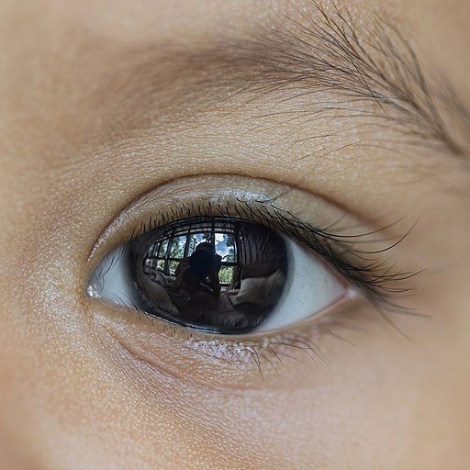
PRESENT Look in the Mirror! What do we see?
3

Slide 17
PRESENT: Look in the Mirror! What do we see?
3
What are your current realities? What’s Going On?
Analyze your Symptoms and possible Causes
Identify your current Strengths and Weaknesses
How should you gather “data” about yourself and your situations?
Who might help you take a look at yourself and your situations?
Notes:
Removed this question, since the participants won’t be discussing it in a break-out room: BUT I WILL SAY THIS OUT LOUD
How might your type preferences influence the way you take inventory of your current strengths, weaknesses, resources?

Slide 18
Speculations regarding type preference influences on assessing your PRESENT state
E’s may tend to seek “data” about themselves from others; Make sense of their self-assessment by talking with others; View self broadly, maybe superficially
I’s may tend to deeply reflect about themselves; Resist generalizations; Share their self-discoveries with only a few; Feel comfortable reflecting in silence
S’s may tend to want their self data to be based on facts; Gather too many details; Emphasize the practical implications of their self-reflection; Be systematic and persistent in their examination of the details; Use a common sense approach
N’s may tend to include possibilities and speculations as “data” about themselves; Look for patterns in the “data”; Enjoy the complexity of self-reflection; Trust their gut instincts about what is happening; Read between the lines; Ignore some facts that don’t seem to fit
T’s may tend to apply logic and objectively in their self-examination; Choose truth over tact when sharing the results of their self-reflection; Be skeptical; Rationalize/Intellectualize their feelings; Emphasize problems more than strengths
F’s may tend to emphasize what they like/dislike or agree/disagree with; Soft-pedal information related to conflict; Be clear on the strengths of their values/beliefs; Share information about themselves in a manner that maintains harmony
J’s may tend to use a planed and orderly approach to self-reflection; Jump to conclusions; Cut off information too quickly; Compare the “data” they discover with the goals/standards, plans relevant to the situation
P’s may tend to keep things open-ended; Feel indecisive as they view themselves and others; Get easily distracted; Postpone doing the self-reflection; Seek out lots of information; Go about the process of self-reflection in a spontaneous manner
Notes:
Note: edited “soft peddle” to “soft-pedal” --- the origin of the term is musical (the soft pedal on a piano, used to muffle sound).

Slide 19
PICTURE Look forward! What could you look like?
4

Slide 20
PICTURE: Look forward! What could you look like?
4
What is your (or your organization’s) preferred future?
What do you want to become?
What is your potential?
Where do you want to go?
What does your destination brochure look like?

Slide 21
PICTURE: Look forward! What could you look like?
4
Upcoming Question for Break-out Room:
How might your type preferences
influence the way you
develop your mission/vision?

Slide 22
Speculations regarding type preference influences on PICTURING your future state
E’s may tend to gain energy when talking to people about the future me; Be wiling to wing-it; Speculate broadly and optimistically; Focus on the external world of people and things and not their inner self; Be willing to share their vision
I’s may tend to be cautious and self-protective about their futures; Intensely try to discover deep interests in the future; Focus on the inner world of concepts and ideas and not external circumstances; Wait to be asked to share their vision
S’s may tend to be more interested in the facts and what could actually happen; Use their five senses to discover their potential future self; Not make things overly complicated; Mistrust their intuition about their potential; Want to see what others have come up with; Be more short-term oriented
N’s may tend to really enjoy speculating about the future; Try to make their vision a coherent whole; Use theories to guide their thinking; Be quite creative about this step; Feel excited about possible insights; Trust their hunches about the future
T’s may tend to apply the principles of logic to come to conclusions; Appear to be impersonal as they speculate about their future; Be nonchalant about how good things could be; Examine the future from an objective point of view; Come up with solutions to problems more that come up with a vision
F’s may tend to make sure their vision is in line with their values and beliefs; Emphasize a vision that has people being in harmony; Examine how their vision might impact other people; Subjectively bias their thoughts; Evaluate their vision on whether they like it or dislike it
J’s may tend to push for closure and finish the visioning efficiently; Be more decisive and purposeful; Come up with a series of goals and standards; May cut off information too quickly to come up with a comprehensive vision
P’s may tend to keep things open-ended; Get more pleasure from starting to think about their future than to complete this step; Feel more comfortable with the ambiguity associated with visioning; Be prone to second-guessing their vision; Want to know all the ways they could go about visioning
Notes:
If a break-out room is going to brainstorm some thoughts on this topic, this slide should probably be moved to the end of the presentation, after the groups report out.
Or I will just quickly skip by it?
Why did the other slides get 17 point font?

Slide 23
PLAN/PREPARE Look for a map! What’s our plan?
5

Slide 24
PLAN/PREPARE: Look for a map! What’s our plan?
5
What convinces you that change is needed?
What’s your itinerary?
What steps do you need to take? …GPS directions
What resources will be needed?
What do you need to know or do?
Who should you notify/consult/collaborate with?
Notes:
The parenthetical concepts should be expressed VERBALLY, not listed on the slide. Plan to mention these bold-text concepts in your remarks:
What convinces us that change is needed? (the Case for change)
What do we need to know or do? (Training/Development)

Slide 25
PLAN/PREPARE: Look for a map! What’s our plan?
5
Upcoming Question for Break-out Room:
How might your type preferences
influence the way you
create a plan for change?

Slide 26
Speculations regarding type preference influences on PLANNING and PREPARING
E’s may tend to move to action too quickly and not think it through; Involve others in the development of the plan and gain their buy-in; Communicate the plan keeping others informed; Include steps to address external elements
I’s may tend to reflect deeply on what may need to be included; Be reluctant to involve lots of others in the plan’s development; Dedicate time to identify what we are learning as we are planning
S’s may tend to develop an incremental plan…a tactical rather than a transformational plan; Break down the bigger goals into step-by-step actions; paying attention to the details; Translate the conceptual elements of the vision into practical entities; Use their experience base to figure out what to do
N’s may tend to think big picture with a systems view of things; Pay attention to and align the linkages between the many parts; Think longer term…with more far-reaching impact into the future; Be more willing to try things that have never been tried before
T’s may tend to produce a logical series of activities to move from milestone to milestone; Be a bit impersonal in dealing with the emotions associated with planning change; Fail to take politics into account and the impact that may have on success of the plan
F’s may tend to develop a plan that is in line with the espoused values; Avoid or smooth over that might be the avenue for the next breakthrough; Try to please people with the plan; Help people feel a sense of belonging
J’s may tend to come to conclusions too quickly; Not develop contingency plans; Develop ways to hold people accountable
P’s may tend to be open to all possibilities; Second guess decisions made; Fail to follow through
Notes:
If a break-out room is going to brainstorm some thoughts on this topic, this slide should probably be moved to the end of the presentation, after the groups report out.
Or quickly skip by it

Slide 27
PULL/PUSH Look where we’re going! Are we running out of gas?
6

Slide 28
PULL/PUSH: Look where we’re going! Are we running out of gas?
6
Why you can’t do business as usual, what you can become and why?
What are you learning along the way? (AARs) Does learning motivate you? How will you use what you learn?
How will you deal with the awkwardness of transitions?
Anything you need to just fix not throw out? (Problem Solving)
How will you celebrate progress/milestones (Appreciations)
How will you stay on track? (Accountability)
Notes:
The parenthetical concepts should be expressed VERBALLY, not listed on the slide. Consider putting those in your notes, to make the slide less cluttered.

Slide 29
PULL/PUSH: Look where we’re going! Are we running out of gas?
6
Upcoming Question for Break-out Room:
How might your type preferences
keep you motivated to
stick with your plan?

Slide 30
Speculations regarding type preference influences on how you respond to the PULL and PUSH of your situation
E’s may tend to be motivated by doing it quickly; Want to talk about it; Find out who else likes this; Find out if generates energy/enthusiasm
I’s may tend to be motivated by time to reflect on each step; Rehearse steps privately; verify the plan speaks to me
N’s may tend to be motivated by finding the steps to be original/innovative; seeing how it ties to big picture; identify how each step has long term consequences
S’s may tend to be motivated by seeing the plan is practical, methodical, realistic; Knowing the steps to take; seeing this is real not abstract
F’s may tend to be motivated by finding the plan appeals to my values; doing things together with others; seeing the plan as compassionate; soothing feelings that get hurt
T’s may tend to be motivated by seeing the plan really is logical; being able to complain even if I have to do it; being assured this won’t be too touchy feely
J’s may tend to be motivated by seeing we are becoming firm; knowing there is a schedule; seeing the plan is systems oriented
P’s may tend to be motivated by being able to adjust if better things come up; allowing for spontaneity; knowing if anybody will check to see if I do this stuff; being able to keep it casual
Notes:
If a break-out room is going to brainstorm some thoughts on this topic, this slide should probably be moved to the end of the presentation, after the groups report out.

Slide 31
PROMISED LAND Look at what we have become!
7

Slide 32
PROMISED LAND: Look at what we have become!
7
Witness your new identity. You need a new picture ID
Consolidate the various pieces into the bigger picture of the puzzle
Re-assess to check if you made it and to make future plans
Has Change become your new normal?
Notes:
The parenthetical concepts should be expressed VERBALLY, not listed on the slide. Plan to mention this bold-text concept in your remarks:
Has Change become your new normal? (It’s a journey not a destination)

Slide 33
PROMISED LAND: Look at what we have become!
7
Upcoming Question for Break-out Room:
How might your type preferences
influence your reaction to
a new identity/reality?

Slide 34
Speculations regarding type preference influences on reaching the PROMISED LAND
E’s may tend to enjoy sharing their new identity with others; See their new situation as a trial and error learning experience; Be quite optimistic about what they accomplished; Use their new identity to explore even more relationships; Notice everything
I’s may tend to think a lot before sharing their new identity with others; Be cautious about whether it will last; Resist generalizations as people notice new things about them; Wait to be asked about what is new and find small talk difficult when answering; Focus on the internal changes they are now experiencing
S’s may tend to see the trees real clear but not the forest they are now in; Attend to details; Share their new identity in a down to earth manner; Simplify their comprehension of their new identity; Emphasize that common sense is what got them here; Must experience it for awhile in order to really understand it
N’s may tend to notice the patterns (see the forest more than the trees); Ignore some facts that don’t seem to fit; Renew their belief in their own creativity and innovativeness; Feel inspired by their new identity
T’s may tend to impersonally describe their new identity in a logical and objective manner; Be skeptical about their new world; Be nonchalant about the work it took to get here; Emphasize the problems that got resolved more so than the picture achieved; Be a bit insensitive about their feelings
F’s may tend to emphasize the values associated with their new identity; Revel in the relationships that were enhanced by their navigating to the Promised Land; Emphasize the harmony they now have in their life; Encourage others to navigate to their own Promised Land; Feel trusting and maybe over accepting
J’s may tend to move on to the next thing as quickly as they can; Feel good about having truly followed their plan to get here; Emphasize the goals that were accomplished and any deadlines they met; Want to know if there’s a better way to reach the Promised Land
P’s may tend to be flexible about what they have achieved; Maybe second guess their decision to become what they have become; Feel comfortable about the ambiguity of their new sense of identity; Keep their options open; See both sides of what they achieved
Notes:
If a break-out room is going to brainstorm some thoughts on this topic, this slide should probably be moved to the end of the presentation, after the groups report out.
Why did the other slides get 17 point font?

Slide 35
Notes:
Are we there yet? Not quite! We need YOUR perspectives about type preferences and change, so we’re going to invite you to a small-group discussion on one of the 7 Ps.

Slide 36
SMALL-GROUP DISCUSSIONS:
Virtual break-out rooms
1 phase of the change process
Brainstorm connections to type preferences
Guideline documents in the chat
10 minutes
Notes:
Christy will explain the small-group discussion guidelines here, and post the note-taking documents in the Zoom chat.

Slide 37
SMALL-GROUP REPORT: How might your type preferences influence the way you develop your mission/vision?
 | Provocation
 | Past
 | Present
 | Picture
 | Plan/Prepare
 | Pull/Push
 | Promised Land

Slide 38
SMALL-GROUP REPORT: How might your type preferences influence the way you create a plan for change?
 | Provocation
 | Past
 | Present
 | Picture
 | Plan/Prepare
 | Pull/Push
 | Promised Land

Slide 39
SMALL-GROUP REPORT: How might your type preferences keep you motivated to stick with your plan?
 | Provocation
 | Past
 | Present
 | Picture
 | Plan/Prepare
 | Pull/Push
 | Promised Land

Slide 40
SMALL-GROUP REPORT: How might your type preferences influence your reaction to a new identity/reality?
 | Provocation
 | Past
 | Present
 | Picture
 | Plan/Prepare
 | Pull/Push
 | Promised Land

Slide 41
A Few Final Thoughts
Become aware of your typical reactions when faced with a disruptive threat/opportunity…pause and examine
Reflect on past experiences with disruptions in your life…What’s been helpful?
“Inventory” your strengths, weaknesses, resources to deal with the potential change before going forward…Prepare to use the strengths of your personality
Envision what you want the change to become before planning what steps you need to take to deal with the threat or opportunity
Plan the steps and identify what you need to prepare in order to undertake the steps to address the change possibility?
Keep yourself motivated to stay on plan…what is still pulling you toward your vision?…what will continue to push you forward to overcome obstacles/problems?
Recognize things have changed and you are different now that you have executed your plan…don’t fall prey to perfectionism but focus more on what is better now

Slide 42
Contact us for more tips on how navigate the 7P’s of change Greg Huszczo & Christy Hicks
Navigating Change: Personally, Professionally & Organizationally
Resources available at:
www.TeamsLeadershipChange.com
Notes:
Christy will post the Survey Monkey link in the Zoom chat at this point in the session: https://www.surveymonkey.com/r/RH25NSY

Slide 43
The True story of Tanya

Slide 44
Tanya’s PROVOCATION: It all started with a rumor
Notes:
Provocation: Rumor her auto plant may close

Slide 45
Tanya reflects on her PAST: Resilience, and rising to challenges
Notes:
Past: Learned to be resilient and rise to the challenges

Slide 46
Tanya’s PRESENT realities: Substantial Strengths, but Vulnerable Situation
Notes:
Present: Smart, good problem solver, not afraid of technology, active in Union, single back female in an organization dominated by older white men, Family supportive after pregnancies without marriage

Slide 47
Tanya PICTURES a preferred future: Learning, Seen as a Professional and Supporting her Family
Notes:
Picture: A job where she is learning; Pictured herself as a professional able to support daughters

Slide 48
Tanya PLANS and PREPARES: Securing Resources and Removing Roadblocks
Notes:
Prepare: Bought laptop to apply; Used Library internet; Asked her Aunt to help with the kids nights and weekends; Tolerant of classmates and boring instructor; Got Union to intervene when her supervisor started throwing up roadblocks; Crammed for the test and passed

Slide 49
Tanya considers the things that PULL her forward and PUSH her back: Exciting New Skills and Supportive Family/Friends (But will she find the time)
Notes:
Pull/Push: Family bragged she was in this program; Excitement of learning something useful; Talked with old friend who went back to school and loved her new life; Realized these skills would result in promotion at plant and knew the skills were transferable even if the plant should close; Enjoyed dressing “like a professional;” Heard a raise was likely

Slide 50
Tanya’s PROMISED LAND: New Role; New Identity
Notes:
Promised Land: Finished the program; Got placed in technical position; Made more money, Now had time to reconnect fully with her kids; Started getting harassed by a guy in new department but HR helped; Family proud; Had a new identity and even seen as a role model for others to follow

